Slide 1


SMART INDIA HACKATHON 2025
Problem Statement ID – SIH25016
Problem Statement - Automated Student Attendance Monitoring and Analytics System for Colleges
Theme - Smart Education
PS Category – Software
Team ID - From portal
Team Name – AttendSmart

Slide 2

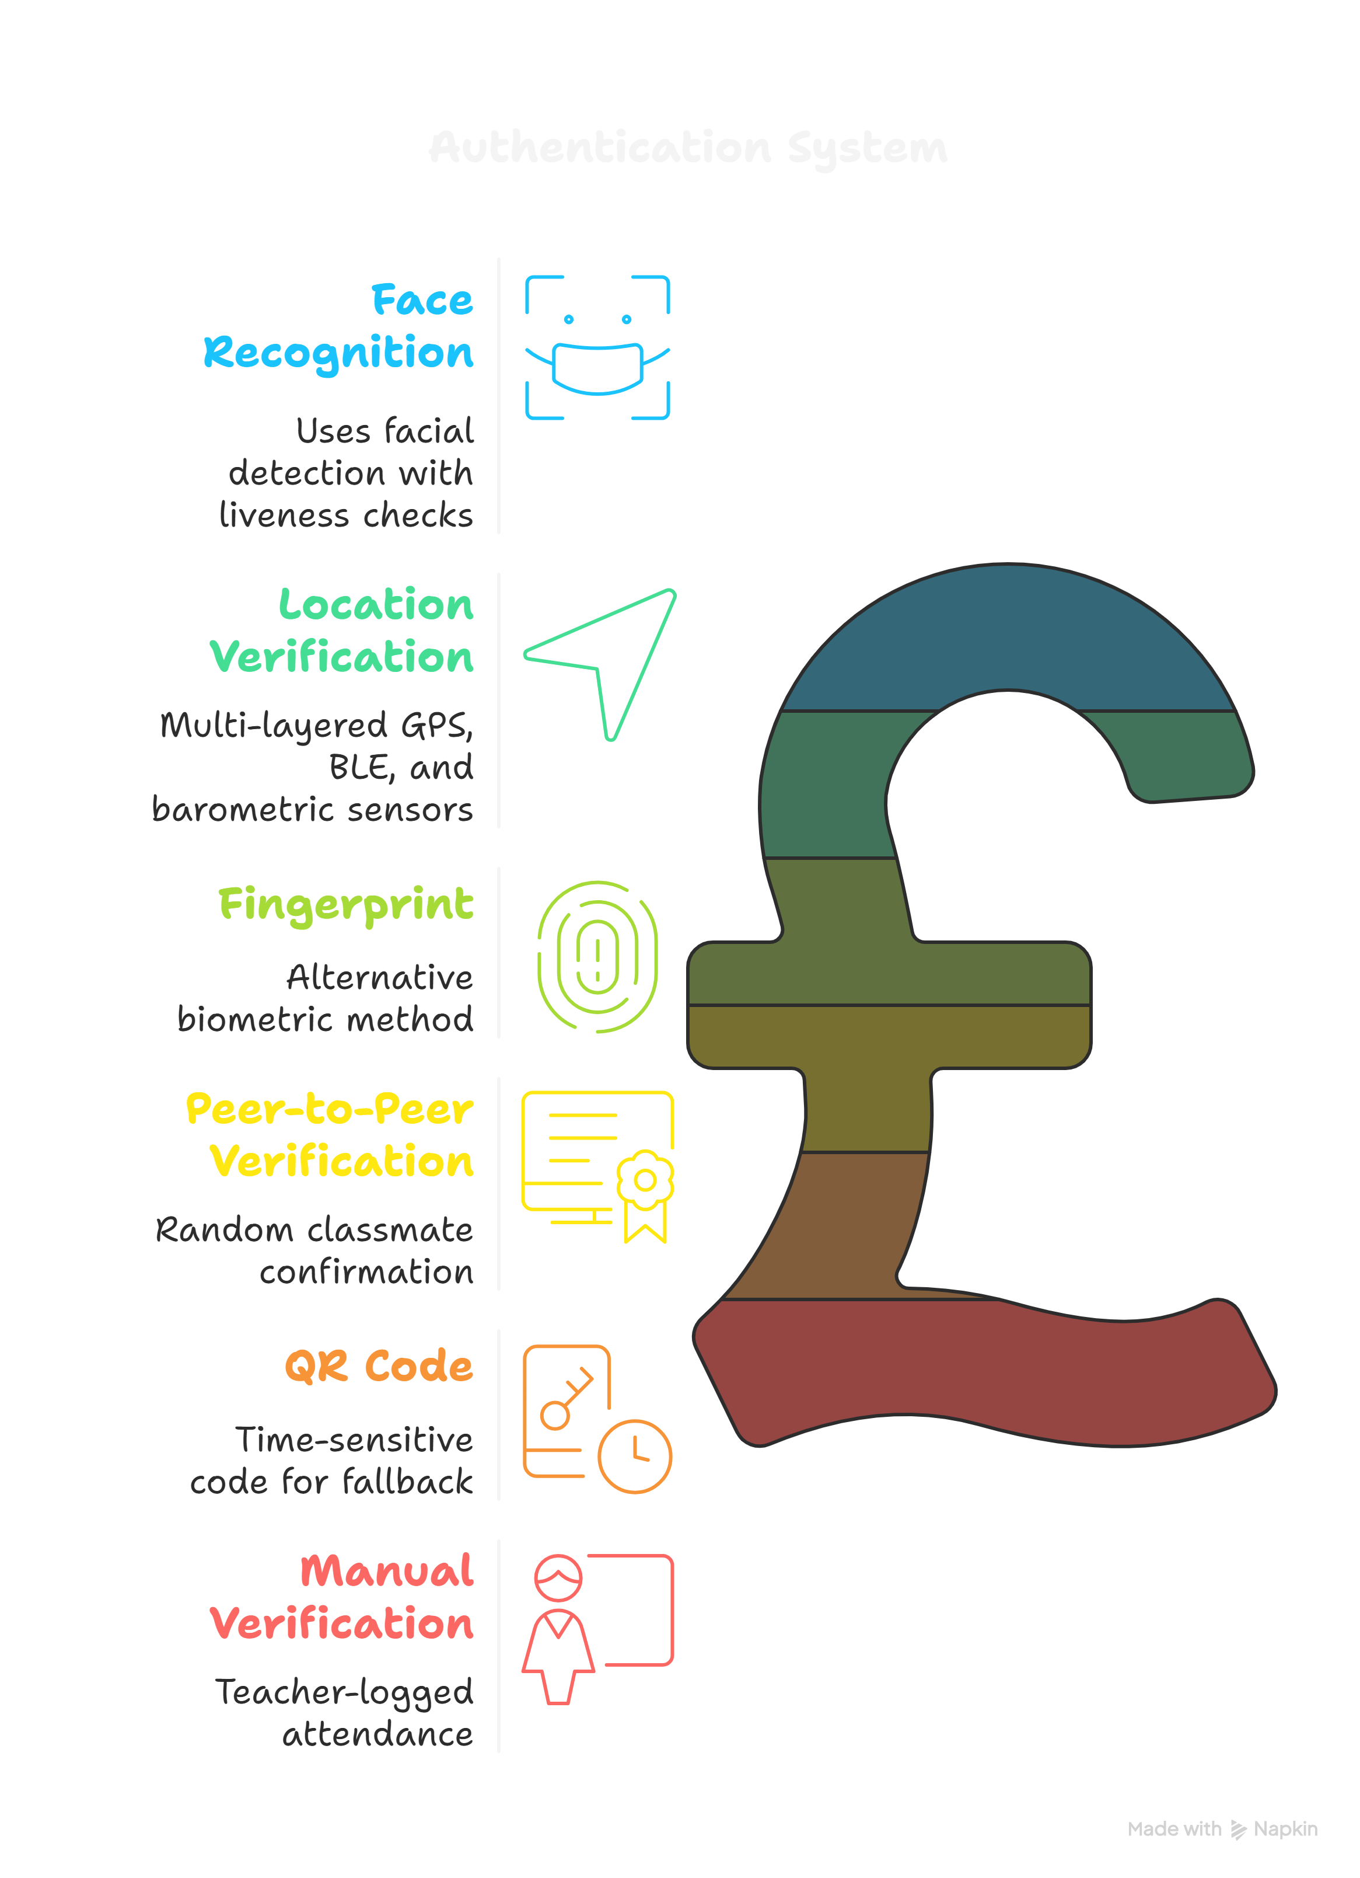

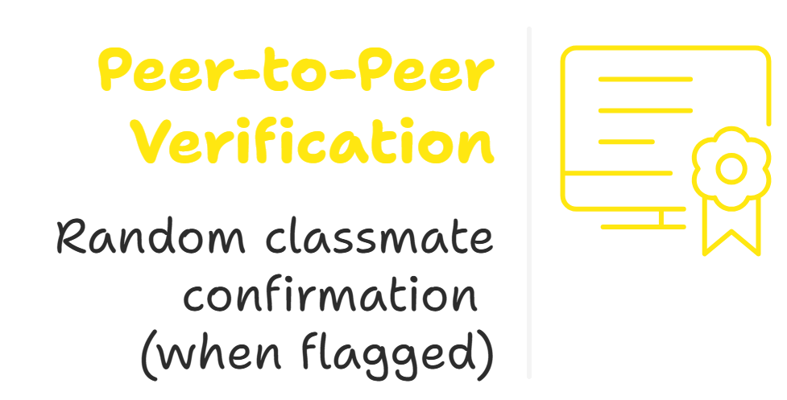
Attend Smart
AttendSmart
Detailed explanation of proposed solution
Problem Statement:
Proposed Solution:
We propose a proxy-proof attendance system that uses a mobile app for multi-factor verification: face liveness, BLE proximity, and barometer checks. It features a live teacher dashboard, operates
100% offline to ensure privacy and accuracy, and completely eliminates proxy attendance
Large classes → harder to track
Manual roll calls & paper registers waste time
Errors & proxy attendance can occur
No easy insights for faculty/admin
Outdated system slows digital transformation
Authentications
Our Project Promises:
Saves time
No proxy or errors
Secure, offline-first with local biometric handling
Instant teacher insights
Easy to use
Primary
For better understanding watch this video
Secondary
Fallbacks
https://youtube.com/playlist?list=PLZghJ684ztTeF9GQ2ZqvPMktYVlb5e7lk&si=yODhyAmdDXDmYw-V

Slide 3
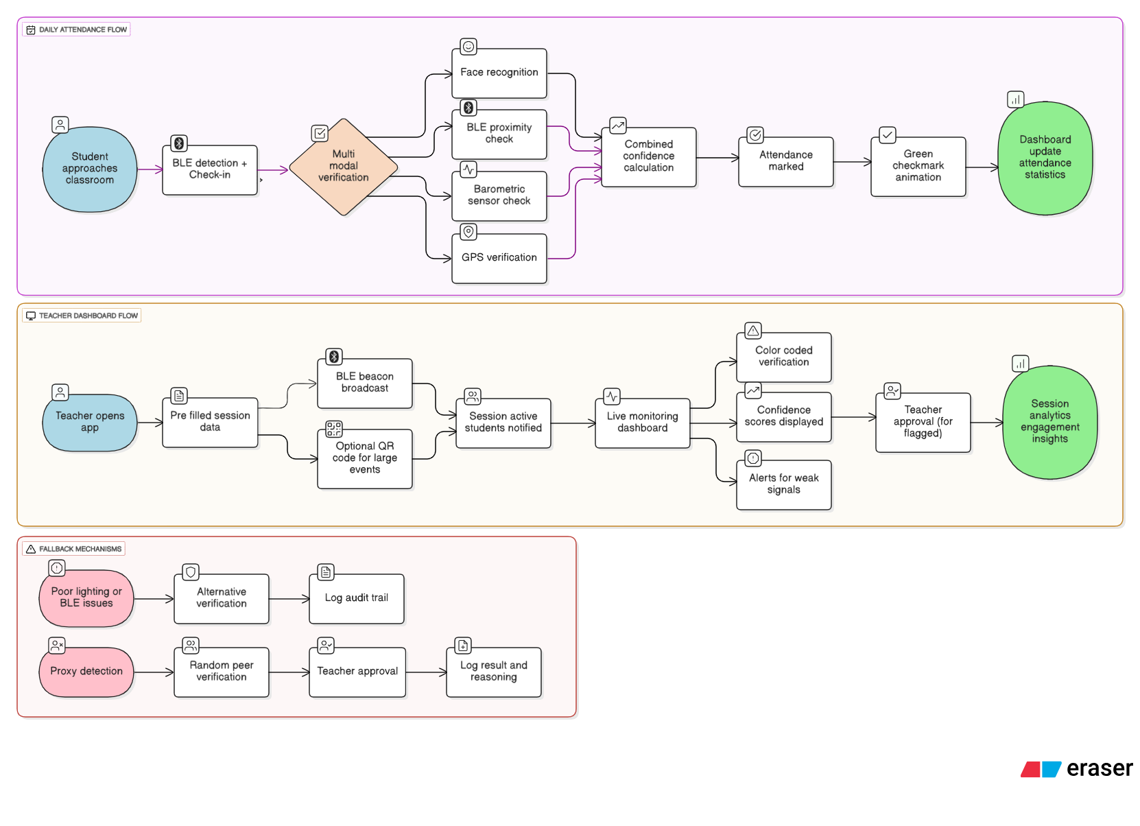
Attend Smart
TECHNICAL APPROACH
with smile
Check out our Prototype Demo Video
https://youtube.com/playlist?list=PLZghJ684ztTeF9GQ2ZqvPMktYVlb5e7lk&si=yODhyAmdDXDmYw-V

Slide 4
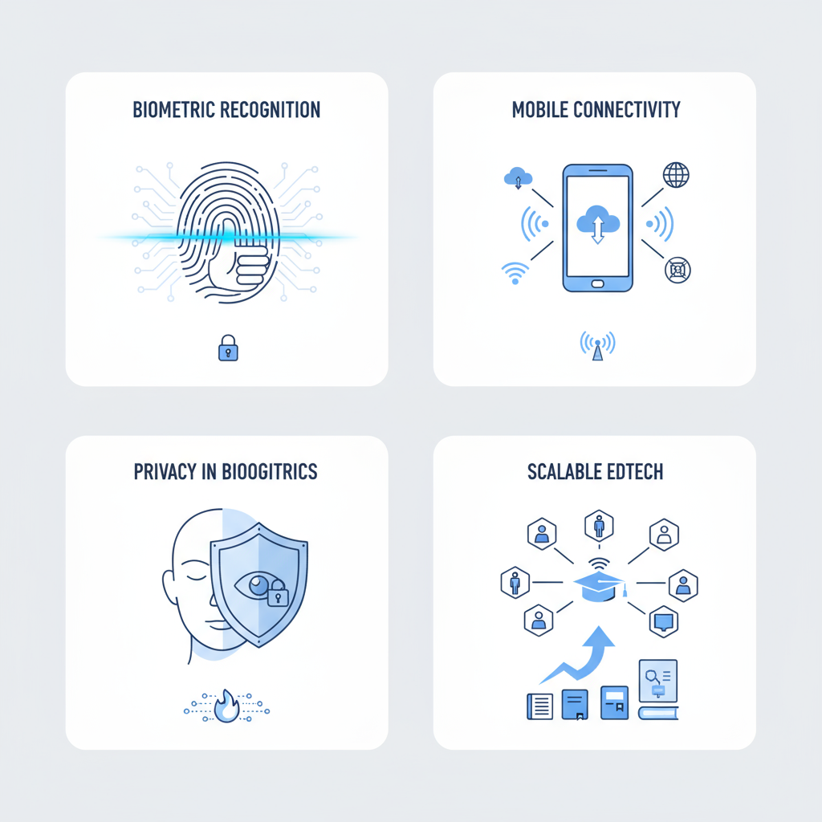
Attend Smart
FEASIBILITY AND VIABILITY
Analysis of the feasibility of the idea
Strategies to overcome:
Potential challenges:
Use proven face recognition models and liveness checks for reliability
Offline-first app and battery optimizations for minimal power/network use
All biometric processing on device; no cloud storage; transparent data policy
Modular, cloud-compatible backend for large-scale deployment
Continuous UX feedback loop with students and teachers
Accuracy of biometric recognition in
varying lighting/conditions
Connectivity/battery issues on older mobile devices
Privacy or resistance to on-device biometrics
Scaling and managing data for thousands or millions of students

Slide 5
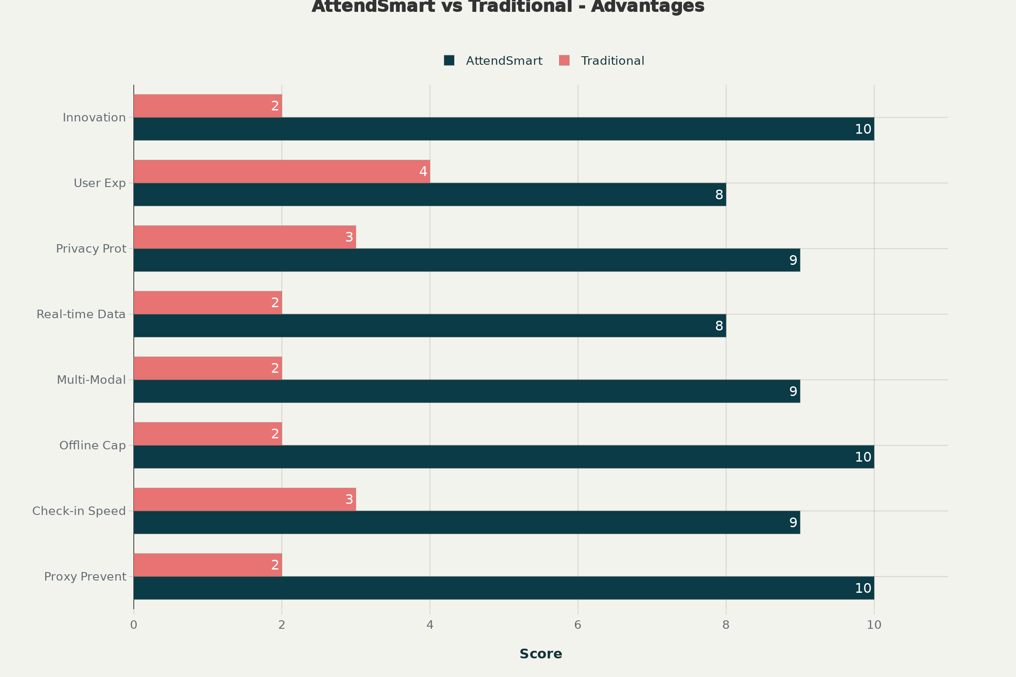
Attend Smart
IMPACT AND BENEFITS
Impact:
Proxy‑proof attendance: Face + BLE + GPS + Barometer.
3–5s check‑in; saves 15+ min/class.
100% offline; on‑device biometrics
Analogy:
Manual gate → e‑gate.
2FA for attendance: “who” + “where.”
Benefits:
Efficiency: 3–5s per student; auto session detection
Accuracy: 95%+ with liveness; <0.1% false positives
Scale & privacy: offline‑first, state‑ready, data stays on device.

Slide 6
Attend Smart
RESEARCH AND REFERENCES
Reference | Technology Focus | AttendSmart Connection | Citations
[1] N. Surantha et al., 'Lightweight face recognition-based portable attendance system with anti-spoofing,' ScienceDirect, 2024 | Face Recognition + Anti-Spoofing | Liveness detection (smile/blink) to prevent photo spoofing | 22 citations
[2] H. Xia et al., 'Using Multiple Barometers to Detect Floor Location of Smart Phones,' PMC, 2015 | Barometric Floor Positioning | Floor-level verification using smartphone sensors | 136 citations
[3] R. Lodha et al., 'Bluetooth Smart Based Attendance Management System,' Procedia Computer Science, 2015 | BLE Proximity Detection | 8-meter proximity verification using Bluetooth Low Energy | 200+ citations
[4] D. Saraswat et al., 'Anti-spoofing-enabled Contactless Attendance Monitoring System,' PMC, 2023 | Contactless Anti-Spoofing | Proxy prevention through contactless biometric verification | 20 citations
[5] J. Samatha et al., 'Smart attendance monitoring system using multimodal biometric authentication,' 2025 | Multi-Modal Integration | Multiple verification layers for enhanced security | Recent publication

